Slide 1
Queue
A queue is an ordered collections of items from which items may be deleted at one end called the front of the queue and in to which items may be inserted at the other end called rear of the queue.

Slide 2


Slide 3
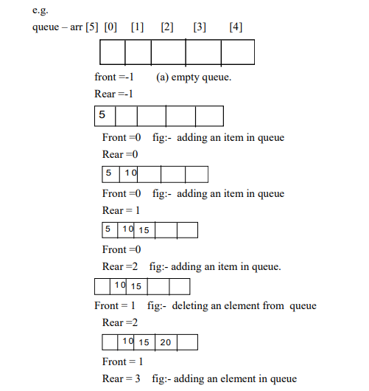

Slide 4
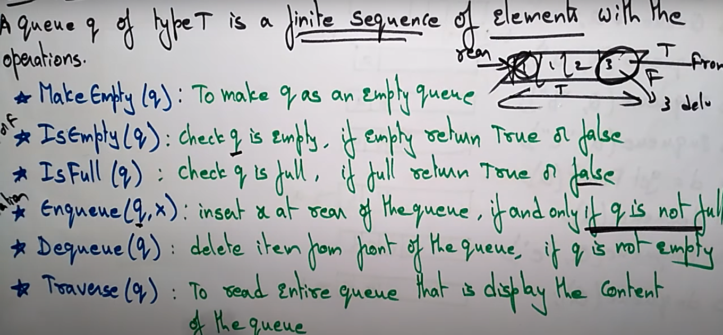
Queue as an ADT

Slide 5
Queue Implementation
array implementation
linked list implementation

Slide 6
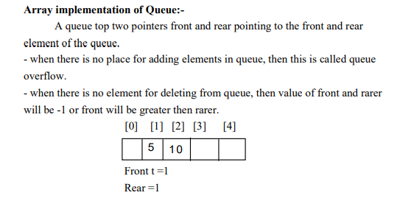

Slide 7
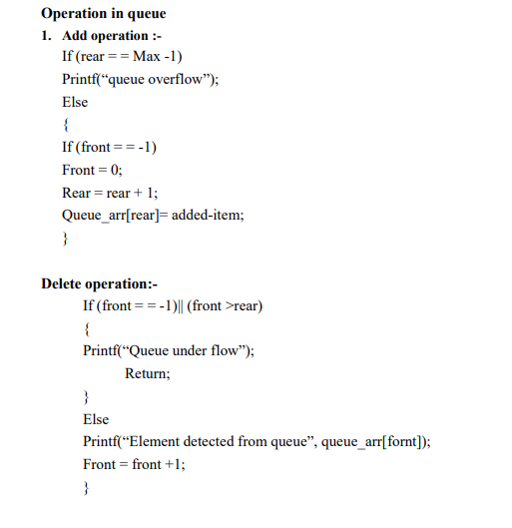

Slide 8
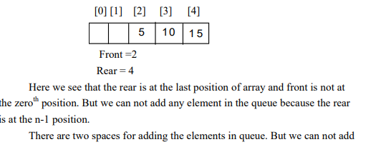
Drawbacks:-

Slide 9
any element in queue because are is at the last position of array. One way is to shift all the elements of array to left and change the position of front and rear but it is not practically good approach. To overcome this type of problem we use the concept of circular queue.

Slide 10
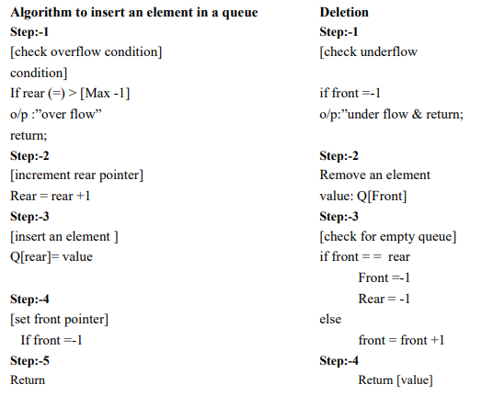

Slide 11
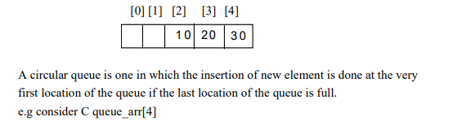
Circular Queue:-

Slide 12
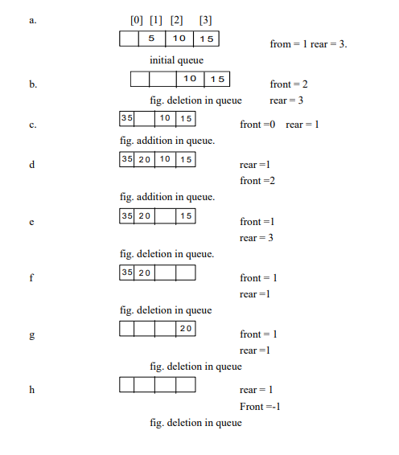

Slide 13
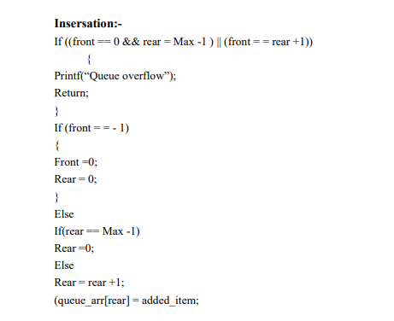

Slide 14
Deletion:-
If (front = = -1
{ printf(“queue underflow”);
Return;
}
Else
Printf(“element deleted from queue is %d”); (queue_arr[front];
If (front == rear)
{
Front =-1;
Rear = -1;
} Else
If (front = = Max – 1)
Front = 0;
Else Front =
front +1;

Slide 15
Dequeue (Double ended queue)
In dequeue we can add or delete the element from both sides i.e. front end or form the rear end. It is of two types.
(i) I/P restricted
(ii) O/P
In input restricted dequeue element can be added at only one end but we can delete the element from both sides.
In output restricted dequeue element can be added from both side but deletion is allowed only at one end.

Slide 16
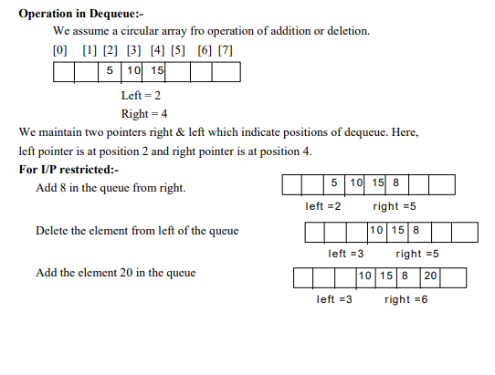

Slide 17
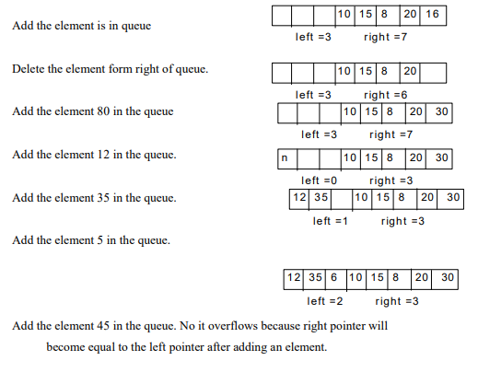

Slide 18
Right addition:-
If(left = = 0 && right == Max -1) || (left = = right +1))
{
Printf(“Queue overflow”);
Return;
}
If (left==-1)
{
Left =0; Right =0;
}
Else If (right = = Max -1)
Right = 0;
Else
Right = right +1;
Dedequeue_arr[right] = added_item

Slide 19
Left Addition:-
Left Addition:- If (( left == 0 && right == Max-1) || (left == right +1))
{ Printf(“Queue overflow”);
Return;
}
If (left==-1)
{ Left =0;
Right =0;
}
Else
If (left == 0)
Left = Max -1;
Else
Left = left -1;
Dequeue_arr[left] = added_item;

Slide 20
Delete left:-
If (left==-1)
{
Printf(“Queue flow”);
Return;
}
Printf(“Element deletd from queue is “%d”, dequeue_arr[left]. // point delete item
If (left == right ) // make empty
{ Left ==-1;
Right =-1;
}
Else
If(left== Max -1) //move from zero.
Left =0;
Else
Left = left +1; // increase space.

Slide 21
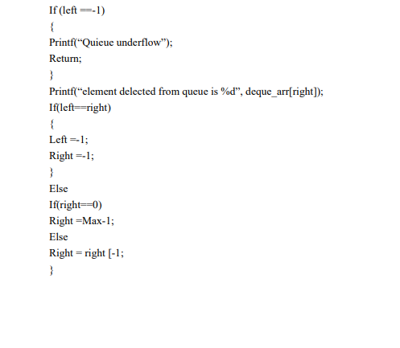
Delete Right:-

Slide 22
Priority Queue
Priority Queue is an abstract data type that is similar to a queue, and every element has some priority value associated with it. The priority of the elements in a priority queue determines the order in which elements are served (i.e., the order in which they are removed). If in any case the elements have same priority, they are served as per their ordering in the queue.

Slide 23
Properties of Priority Queue
Every item has a priority associated with it.
An element with high priority is dequeued before an element with low priority.
If two elements have the same priority, they are served according to their order in the queue.

Slide 24
Operations of a Priority Queue:
Insertion in a Priority Queue
Deletion in a Priority Queue
Peek in a Priority Queue:This operation helps to return the maximum element from Max Heap or the minimum element from Min Heap without deleting the node from the priority queue.

Slide 25
Types of Priority Queue:
Ascending Order Priority Queue
As the name suggests, in ascending order priority queue, the element with a lower priority value is given a higher priority in the priority list. For example, if we have the following elements in a priority queue arranged in ascending order like 4,6,8,9,10. Here, 4 is the smallest number, therefore, it will get the highest priority in a priority queue.

Slide 26
Descending order Priority Queue
The root node is the maximum element in a max heap, as you may know. It will also remove the element with the highest priority first. As a result, the root node is removed from the queue. This deletion leaves an empty space, which will be filled with fresh insertions in the future. The heap invariant is then maintained by comparing the newly inserted element to all other entries in the queue.

